Slide 1



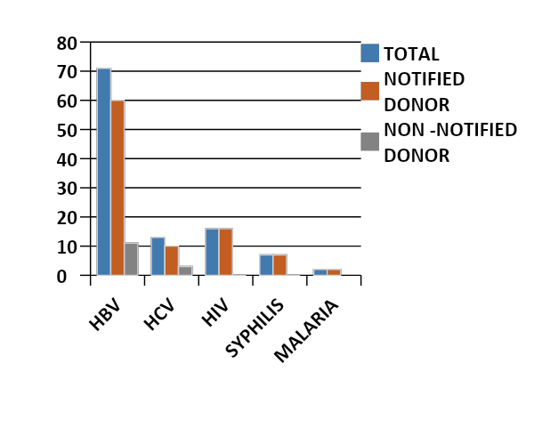
REACTIVE DONOR NOTIFICATION AND COUNSELING
PRATHIBA E N , MANIMALA S A ,RAVISHANKAR J
Department of IHBT ,Tirunelveli Medical College Hospital
Introduction
Methods
Results
Donor notification and counselling is a part of comprehensive donor care and essential for early clinical intervention to minimize their disease and reduce the risk of secondary transmission of infection
To determine the response rate of TTI reactive donors after notifying their abnormal screening test results
The reactive donors were notified about their reactive status and called for face to face counseling,retesting and referred to Medical gastroenterology (HBV,HCV) ICTC(HIV) ,STI clinic (syphilis) & General medicine (Malaria) for further management
Out of 24494 donations 109(0.44%) donors were reactive.87.1% (n=95/109) could be contacted.86% (n= 82/95) returned for counseling and retesting.14.63% (n=12/82) were non reactive in retesting
HBV:HCV:HIV:SYP:MAL=71:13:16:7:2
Conclusions
DISTRIBUTION OF REACTIVE DONORS
Methods
Pre donation counseling on TTI and obtaining correct demographic details are needed for good response after notification .Newer avenues like National Viral Hepatitis Control Program should be utilized for donr follow-up
Retrospective descriptive study conducted over a period of 3 years (1 Jan 2019- 31 Dec 2021). All units donated were subjected to TTI screening and the reactive donors were notified through telephone calls.If no response after three calls,details of the donor were reported to District Aids Prevention and Control Unit(to reach donor by outreach worker) by blood bank counselor
References
Contents (10pt or more)

